Slide 1
Session II : Agile Awareness

Slide 2

Agile Where Am I ??????

Slide 3
What is Agile?
An alternative to documentation driven, heavyweight software development
A way to respond to “Change in Requirements” during the Software Development
Reduce efforts involved in planning and estimation
Focus on team interaction, customer satisfaction and early delivery of working software
Progressive Elaboration involves continuously improving and detailing a plan as more detailed and specific information and more accurate estimates become available
Progressive Elaboration allows a project management team to manage to a greater level of details as the project evolves
- Ref. PMBOK V4

Slide 4
Agile - Origin, Value, Principles

Slide 5
Which project will be best suite in Agile ?
Simple
Complicated
Complex
Chaotic

Slide 6
Which project will be best suite in Agile ?
Simple
Complicated
When requirements are clear;
Ex : Frying a burger
(just repeating the process)
Complex
Chaotic

Slide 7
Which project will be best suite in Agile ?
Simple
Complicated
When requirements are clear;
Ex : Frying a burger
(just repeating the process)
Complex
Chaotic

Slide 8
Which project will be best suite in Agile ?
Simple
Complicated
When requirements are clear;
Ex : Frying a burger
(just repeating the process)
When requirements are clear;
Ex : Laying network cables
(High level plan and low level plan)
Complex
Chaotic

Slide 9
Which project will be best suite in Agile ?
Simple
Complicated
When requirements are clear;
Ex : Frying a burger
(just repeating the process)
When requirements are clear;
Ex : Laying network cables
(High level plan and low level plan)
Complex
Chaotic
Ex : Heart Transplantation

Slide 10
Which project will be best suite in Agile ?
Simple
Complicated
When requirements are clear;
Ex : Frying a burger
(just repeating the process)
When requirements are clear;
Ex : Laying network cables
(High level plan and low level plan)
Complex
Chaotic
Ex : Heart Transplantation
No model is applicable, as such

Slide 11
Which project will be best suite in Agile ?
Simple
Complicated
When requirements are clear;
Ex : Frying a burger
(just repeating the process)
When requirements are clear;
Ex : Laying network cables
(High level plan and low level plan)
Complex
Chaotic
Ex : Heart Transplantation
No model is applicable, as such

Slide 12
What is Agile?
Agile SDLC model is a combination of iterative and incremental process models with focus on process adaptability and customer satisfaction by rapid delivery of working software product.
Agile Methods break the product into small incremental builds. These builds are provided in iterations. Each iteration typically lasts from about one to three weeks.
Every iteration involves cross functional teams working simultaneously on various areas like −
Planning
Requirements Analysis
Design
Coding
Unit Testing and
Acceptance Testing.
At the end of the iteration, a working product is displayed to the customer and important stakeholders.

Slide 13
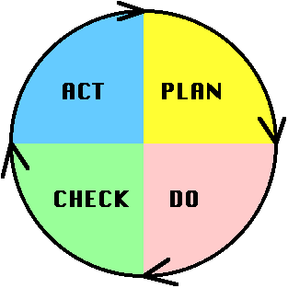
What is Agile?
Based on Edwards Deming PDCA cycle
PLAN: Design or revise business process components to improve results
DO: Implement the plan and measure its performance
CHECK: Assess the measurements and report the results to decision makers
ACT: Decide on changes needed to improve the process

Slide 14

Origin
Defined on February 11-13, 2001, at Snowbird ski resort in the Wasatch mountains of Utah by seventeen people
"The Agile Alliance," this group of independent thinkers about software development, and sometimes competitors to each other, agreed on the Manifesto for Agile Software
www.agilealliance.org
Notes:
On February 11-13, 2001, at The Lodge at Snowbird ski resort in the Wasatch mountains of Utah, seventeen people met to talk, ski, relax, and try to find common ground?and of course, to eat. What emerged was the Agile ?Software Development? Manifesto. Representatives from Extreme Programming, SCRUM, DSDM, Adaptive Software Development, Crystal, Feature-Driven Development, Pragmatic Programming, and others sympathetic to the need for an alternative to documentation driven, heavyweight software development processes convened.
Now, a bigger gathering of organizational anarchists would be hard to find, so what emerged from this meeting was symbolic?a Manifesto for Agile Software Development?signed by all participants. The only concern with the term agile came from Martin Fowler (a Brit for those who don?t know him) who allowed that most Americans didn?t know how to pronounce the word ?agile?.
Alistair Cockburn?s initial concerns reflected the early thoughts of many participants. "I personally didn't expect that this particular group of agilites to ever agree on anything substantive." But his post-meeting feelings were also shared, "Speaking for myself, I am delighted by the final phrasing [of the Manifesto]. I was surprised that the others appeared equally delighted by the final phrasing. So we did agree on something substantive."
Naming ourselves "The Agile Alliance," this group of independent thinkers about software development, and sometimes competitors to each other, agreed on the Manifesto for Agile Software Development displayed on the title page of this web site.
But while the Manifesto provides some specific ideas, there is a deeper theme that drives many, but not all, to be sure, members of the alliance. At the close of the two-day meeting, Bob Martin joked that he was about to make a "mushy" statement. But while tinged with humor, few disagreed with Bob?s sentiments?that we all felt privileged to work with a group of people who held a set of compatible values, a set of values based on trust and respect for each other and promoting organizational models based on people, collaboration, and building the types of organizational communities in which we would want to work. At the core, I believe Agile Methodologists are really about "mushy" stuff?about delivering good products to customers by operating in an environment that does more than talk about "people as our most important asset" but actually "acts" as if people were the most important, and lose the word "asset". So in the final analysis, the meteoric rise of interest in?and sometimes tremendous criticism of?Agile Methodologies is about the mushy stuff of values and culture.
For example, I think that ultimately, Extreme Programming has mushroomed in use and interest, not because of pair-programming or refactoring, but because, taken as a whole, the practices define a developer community freed from the baggage of Dilbertesque corporations. Kent Beck tells the story of an early job in which he estimated a programming effort of six weeks for two people. After his manager reassigned the other programmer at the beginning of the project, he completed the project in twelve weeks?and felt terrible about himself! The boss?of course?harangued Kent about how slow he was throughout the second six weeks. Kent, somewhat despondent because he was such a "failure" as a programmer, finally realized that his original estimate of 6 weeks was extremely accurate?for 2 people?and that his "failure" was really the manager?s failure , indeed, the failure of the standard "fixed" process mindset that so frequently plagues our industry.
This type of situation goes on every day?marketing, or management, or external customers, internal customers, and, yes, even developers?don?t want to make hard trade-off decisions, so they impose irrational demands through the imposition of corporate power structures. This isn?t merely a software development problem, it runs throughout Dilbertesque organizations.
In order to succeed in the new economy, to move aggressively into the era of e-business, e-commerce, and the web, companies have to rid themselves of their Dilbert manifestations of make-work and arcane policies. This freedom from the inanities of corporate life attracts proponents of Agile Methodologies, and scares the begeebers (you can?t use the word ?shit? in a professional paper) out of traditionalists. Quite frankly, the Agile approaches scare corporate bureaucrats? at least those that are happy pushing process for process? sake versus trying to do the best for the "customer" and deliver something timely and tangible and "as promised"?because they run out of places to hide.
The Agile movement is not anti-methodology, in fact, many of us want to restore credibility to the word methodology. We want to restore a balance. We embrace modeling, but not in order to file some diagram in a dusty corporate repository. We embrace documentation, but not hundreds of pages of never-maintained and rarely-used tomes. We plan, but recognize the limits of planning in a turbulent environment. Those who would brand proponents of XP or SCRUM or any of the other Agile Methodologies as "hackers" are ignorant of both the methodologies and the original definition of the term hacker.
The meeting at Snowbird was incubated at an earlier get together of Extreme Programming proponents, and a few "outsiders," organized by Kent Beck at the Rogue River Lodge in Oregon in the spring of 2000. At the Rogue River meeting attendees voiced support for a variety of "Light" methodologies, but nothing formal occurred. During 2000 a number of articles were written that referenced the category of "Light" or "Lightweight" processes. A number these articles referred to "Light methodologies, such as Extreme Programming, Adaptive Software Development, Crystal, and SCRUM". In conversations, no one really liked the moniker "Light", but it seemed to stick for the time being.
In September 2000, Bob Martin from Object Mentor in Chicago, started the next meeting ball rolling with an email; "I'd like to convene a small (two day) conference in the January to February 2001 timeframe here in Chicago. The purpose of this conference is to get all the lightweight method leaders in one room. All of you are invited; and I'd be interested to know who else I should approach." Bob set up a Wiki site and the discussions raged.
Early on, Alistair Cockburn weighed in with an epistle that identified the general disgruntlement with the word ?Light?: "I don't mind the methodology being called light in weight, but I'm not sure I want to be referred to as a lightweight attending a lightweight methodologists meeting. It somehow sounds like a bunch of skinny, feebleminded lightweight people trying to remember what day it is."
The fiercest debate was over location! There was serious concern about Chicago in wintertime?cold and nothing fun to do; Snowbird, Utah?cold, but fun things to do, at least for those who ski on their heads like Martin Fowler tried on day one; and Anguilla in the Caribbean?warm and fun, but time consuming to get to. In the end, Snowbird and skiing won out; however, a few people?like Ron Jeffries?want a warmer place next time.
We hope that our work together as the Agile Alliance helps others in our profession to think about software development, methodologies, and organizations, in new? more agile ? ways. If so, we?ve accomplished our goals.
Jim Highsmith, for the Agile Alliance

Slide 15
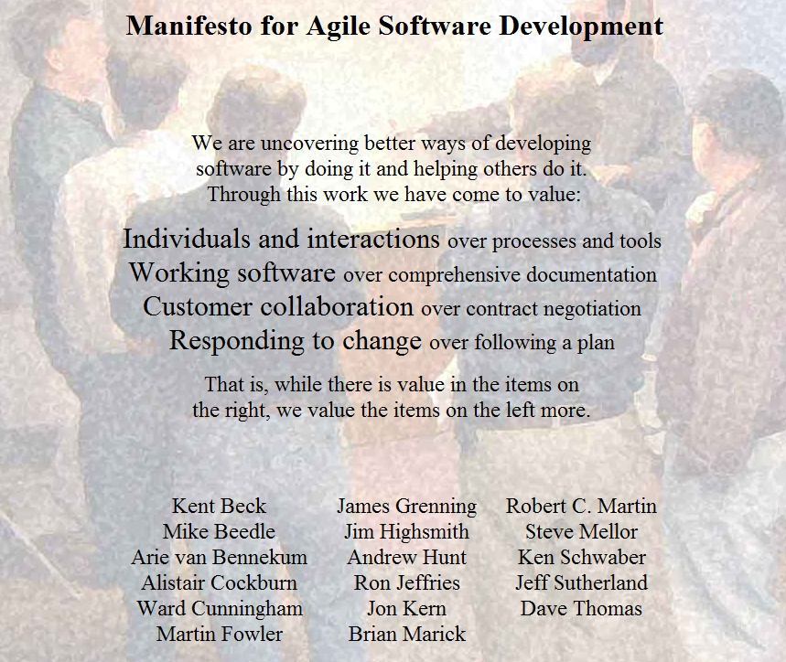
Agile Values
Notes:
We are uncovering better ways of developing software by doing it and helping others do it. Through this work we have come to value:
Individuals and interactions over processes and tools Working software over comprehensive documentation Customer collaboration over contract negotiation Responding to change over following a plan
That is, while there is value in the items on the right, we value the items on the left more.

Slide 16
Agile Principles
Our highest priority is to satisfy the customer through early and continuous delivery of valuable software
Welcome changing requirements, even late in development. Agile processes harness change for the customer's competitive advantage
Deliver working software frequently, from a couple of weeks to a couple of months, with a preference to the shorter timescale
Business people and developers must work together daily throughout the project
Build projects around motivated individuals. Give them the environment and support they need, and trust them to get the job done
At regular intervals, the team reflects on how to become more effective, then tunes and adjusts its behavior accordingly
The most efficient and effective method of conveying information to and within a development team is face-to-face conversation
Working software is the primary measure of progress
Agile processes promote sustainable development. The sponsors, developers, and users should be able to maintain a constant pace indefinitely
Continuous attention to technical excellence and good design enhances agility
Simplicity- the art of maximizing the amount of work not done - is essential
The best architectures, requirements, and designs emerge from self-organizing teams
Notes:
Principles behind the Agile Manifesto We follow these principles:
1. Our highest priority is to satisfy the customer through early and continuous delivery of valuable software.
2. Welcome changing requirements, even late in development. Agile processes harness change for the customer's competitive advantage.
3. Deliver working software frequently, from a couple of weeks to a couple of months, with a preference to the shorter timescale.
4. Business people and developers must work together daily throughout the project.
5. Build projects around motivated individuals. Give them the environment and support they need, and trust them to get the job done.
6. The most efficient and effective method of conveying information to and within a development team is face-to-face conversation.
7. Working software is the primary measure of progress.
8. Agile processes promote sustainable development. The sponsors, developers, and users should be able to maintain a constant pace indefinitely.
9. Continuous attention to technical excellence and good design enhances agility.
10. Simplicity--the art of maximizing the amount of work not done--is essential.
11. The best architectures, requirements, and designs emerge from self-organizing teams.
12. At regular intervals, the team reflects on how to become more effective, then tunes and adjusts its behavior accordingly.

Slide 17
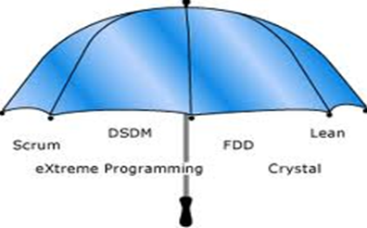
Agile Methodologies
SCRUM
3 Roles
4 Ceremonies
3 Artifacts
Lean
7 Principles
8 Wastes
22 Thinking Tools
XP
5 Values
12 Primary Practices
11 Corollary Practice
Notes:
As we have learnt earlier there are many methodologies under Agile Umbrella

Slide 18
Agile - Scrum

Slide 19
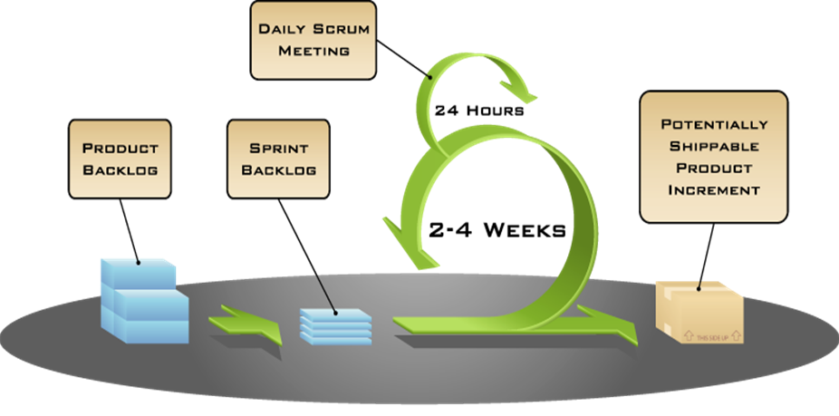
Scrum
Ceremonies
Sprint Planning
Daily Stand Up
Sprint Demo
Sprint Retrospective
Artifacts
Product Backlog
Sprint Backlog
Burn down Chart
Roles
- Product Owner
- Scrum Master
- Team

Slide 20
Attributes of Agile Team – A quick glimpse
No Managers – The team is self-managed
Self-disciplined
Time-boxing
Sustainable
Taking the ownership
Team should be transparent to the customer ( we need to engage the customer in daily development activities)
Cross functional
Continuous learning
Team should be collaborative
Respect your team members / discuss with the team about the problem
Agile supports new ideas / innovations
Agile never bothers about failures
Agile recommends to have face to face communication

Slide 21

User Stories
List of requirement will be specified in an organized way i.e. User Stories
User Stories are the functionalities to be delivered in the Scrum.
Functionalities will be specified User perceptive
Ideal User Story format will be like
As a User <Role> I want < Condition> So that, I can achieve < desired goal>
Objectives of User Stories
Card: Stories are written on note cards and will be divided as tasks
Confirmation: Acceptance test will be conducted Story developed properly

Slide 22
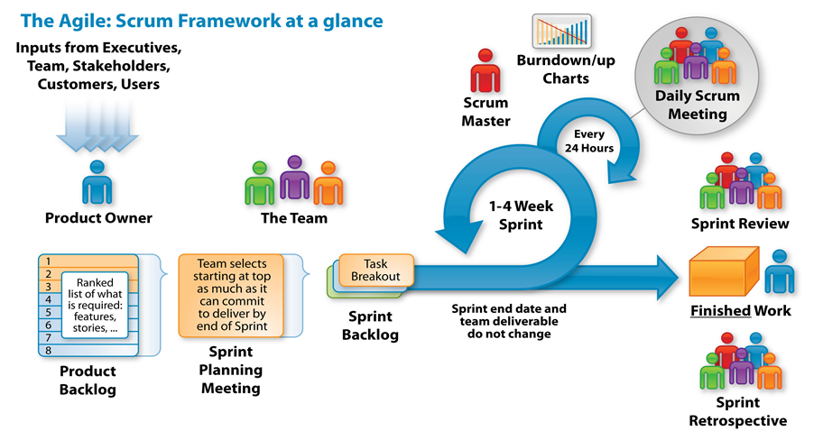
How Scrum Works?
Iterative and Incremental Software Development
.
Amount of work remaining in a Sprint
Team Assess Own Progress
Keeps the Team Focused on its Goal.
A Product Owner creates a Prioritized Wish List
Team Demonstrate …New Functionality
Shippable Functionality
Committed Functionality
Projects move forward via a series of Iterations
The Team pulls a small chunk from the top of the Sprint Backlog, and decides how to implement those pieces.
Team reflects to improve in the new Sprint.

Slide 23
A quick check…..

Slide 24
1. Who is responsible for prioritizing the backlog?
Product Owner
Product Manager
Lead developer
Tester

Slide 25

1. Who is responsible for prioritizing the backlog?
Product Owner
Product Manager
Lead developer
Tester
Product Owner represents the customer and is accountable for ensuring that the team delivers value to the business. The Product Owner writes the customer-focused items (typically user stories) and adds them into Product Backlog.

Slide 26
2. Who one of the following is not a scrum role ?
Product Owner
Scrum Master
Product Manager
Team

Slide 27

2. Who one of the following is not a scrum role ?
Product Owner
Scrum Master
Product Manager
Team
Scrum has only 3 roles and the relationship between these roles is clear and simple.

Slide 28
3. Who one of the following is not a scrum artifact ?
Product Backlog
Story
Sprint Backlog
Burndown Chart

Slide 29

3. Who one of the following is not a scrum artifact ?
Product Backlog
Story
Sprint Backlog
Burndown Chart
In the purest sense of Scrum, there are only 3 artifacts.
Product Backlog, Sprint Backlog and Burndown chart

Slide 30

4. Velocity is a measure of ?
Customer buy-in
Project progress
Executive support
Risk Mitigation

Slide 31

4. Velocity is a measure of ?
Customer buy-in
Project progress
Executive support
Risk Mitigation
Project progress is measured thru velocity.
Velocity is extremely simple and powerful method for accurately measuring the rate at which, teams consistently deliver the business values

Slide 32
5. In the popular priotization rechnique, called “MoSCoW”, “M” stands for?
Mandatory
May Have
Major
Must Have

Slide 33

5. In the popular priotization rechnique, called “MoSCoW”, “M” stands for?
Mandatory
May Have
Major
Must Have
When working with stories from a product backlog, especially during release planning, instead of ranking them numerically, apply the MUST HAVE, SHOULD HAVE, COULD HAVE and WONT HAVE rule to each story.

Slide 34
6. The Scrum Master assigns the tasks to the Team Members. Say True or False
True
False

Slide 35

6. The Scrum Master assigns the tasks to the Team Members. Say True or False
True
False

Slide 36
Agile Certifications

Slide 37



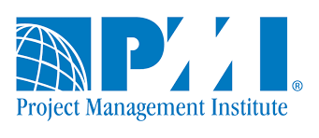



Whom do you like to certify your Agile Knowledge?
International Scrum Institute
Only PMI ask for your hands on experience when you apply for PMI-ACP,
there is no pre-requisite for other certifications

